Slide 1
GCP Serverless computing
Pravin Y Pawar

Slide 2
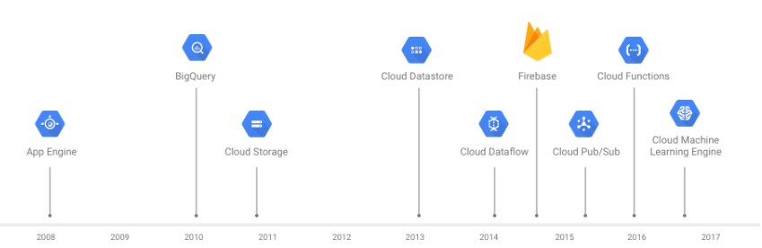
Google Cloud Platform
Serverless
Google Cloud’s serverless platform allows to
build, develop, and deploy functions and applications
as source code or containers
while simplifying the developer experience by eliminating all infrastructure management

Slide 3
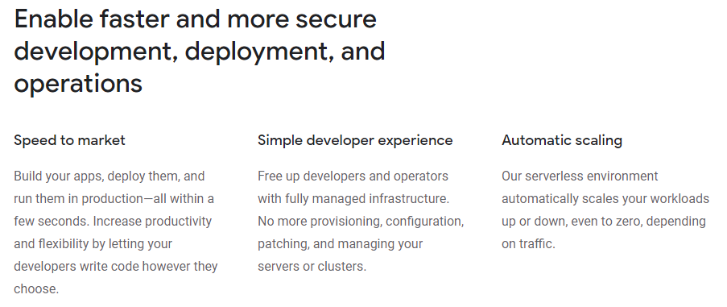
Benefits

Slide 4
Common use cases for serverless compute products
Build scalable, secure web apps
Code, build, and deploy scalable applications in a fully managed environment
designed to help developers to succeed with
built-in security
auto scaling
ops management for faster deployment
Develop, deploy, and manage APIs
Build scalable APIs in an environment built for developers to succeed
Can develop REST APIs for web and mobile backends
Manage the connection between different parts of application and internal cloud services

Slide 5
Common use cases for serverless compute products(2)
Build apps with data processing in mind
Serverless computing environment manages the infrastructure workloads need, in order to handle
auto scaling
Authorization
and event triggers
The pub/sub model of communication makes it easy to ingest and transform large amounts of data and build complex, scalable data pipelines
while saving time on backend confusion
Automate event orchestration
Automatically validate policies or configurations and perform other scripted automation using event triggers
Serverless computing products can listen to events from other clouds, handle webhooks, and manage distributing events and workloads to other components
This built-in ability makes it straightforward for application to handle complex event needs

Slide 6
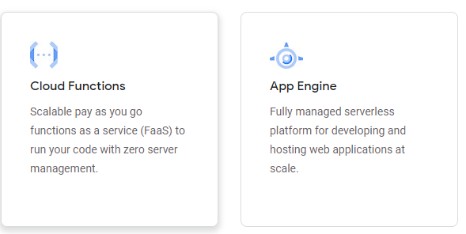
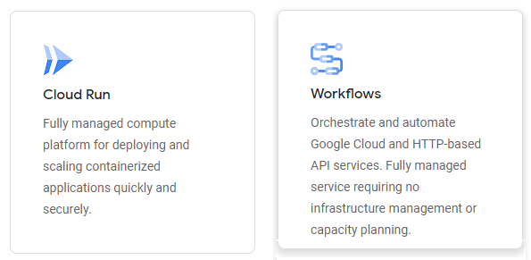
GCP Serverless products

Slide 7
Thank You!
Reference :
GCP Serverless Computing Product pages
In our next session:

